Slide 1
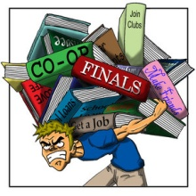
Stress to Students

Slide 2
Some Facts
According to a recent study by Campus Calm, 85% of students say they feel stressed on a daily basis and it is the biggest issue they face. And between 75-90% of the teens physician visits are due to stress-related issues.
Among them around 8-9% teens think the only time there is a total absence of stress is in death.

Slide 3
When Asked To Define Stress, Most
Folks Describe Events –
Like Tests or Exams, Finances, People Who Bother Them, Etc.
But, That Doesn’t Really
Define Stress
At A Basic Level.

Slide 4
Rather Stress is Defined as…

Slide 5
Han Selye defines stress as wear and tear on the body.
Stress is your body's way of responding to any kind of demand.
The threat, event or change are commonly called stressors. Stressors can be internal (thoughts, beliefs, attitudes) or external (loss, tragedy, change).

Slide 6
LEVELS OF STRESS!!!
Distress: Stress from bad sources
Eustress: Good Stress
  Getting into college
  Getting engaged
  Winning the lottery
  Difficult Campus Environment
  Overwhelming sights & sounds
  Threat of Personal Injury

Slide 7
Types of Stress
General Stress
Cumulative Stress
Acute Traumatic Stress
Post Traumatic Stress

Slide 8
FOUR TYPES OF STRESS
1. General Stress:
  Everyone has this kind of stress
  It resolves itself within a day or two
  No intervention is necessarily required

Slide 9
FOUR TYPES OF STRESS
2. Cumulative Stress:
  Stress builds up in your body
  It becomes more difficult to lighten your symptoms
  You may have more serious physical symptoms
  You may have more serious mental sorrow

Slide 10
FOUR TYPES OF STRESS
3. Acute Traumatic Stress:
  Critical Incident Stress
  Produces considerable psychological distress
  A normal reaction to abnormal events

Slide 11
FOUR TYPES OF STRESS
4. Post Traumatic Stress:
  Severe stress produced by severe psychological trauma
  Created by unresolved Critical Incident Stress
  Produces lasting changes

Slide 12
Stress Can do…
Too little stress = bored, unmotivated
Too much stress = overwhelmed, fearful, frozen
Moderate stress = energized, on-task, efficient

Slide 13
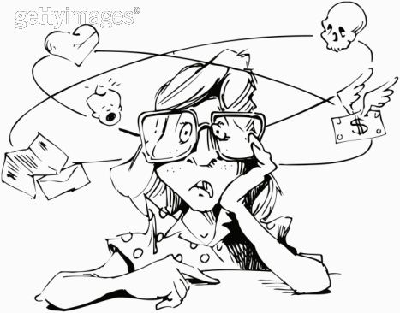
Factors contributing stress among Students
Economic reasons: loan trouble and working while studying
Pure academic load: Math classes, projects, assignment, papers, tests, regularly getting poor grades
Expectations from parents and teachers
Career path: after they’ve worried about the present, their futures are in doubt.
Lack of self esteem
Family Problem
Death of a loved one

Slide 14
Effects of Stress
Psychological Effects
Behavioral Effects
Depressed
Bored
Urge to cry
Urge to hide
Suspiciousness
Negative attitude/thoughts
Loneliness
Nightmares
Excessive daydreaming about “getting away from it all”
Use of sleeping pills
Cigarette smoking
Impulsive behavior
Inappropriate crying
Aggressive
Overeating
Lack of initiative
Drug/Alcohol abuse
Fault finding
Antisocial
Under eating
Forgetfulness regarding appointments, dates, deadlines

Slide 15
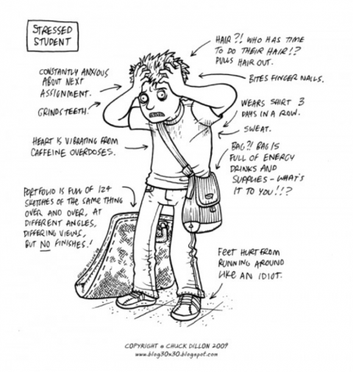
Stress can Cause..
Your effectiveness reduces
You accident prone
You started forgetting things
You neglect your appearance
You make poor judgments
You make more mistakes
Your absenteeism increases
You no longer enjoy classes
You feel difficulty concentrating

Slide 16
Ways to Overcome Stress
Rest: Get a minimum of six hours of continuous rest
Talk things out with someone you trust - a family member or a good friend
Rehearsing and practicing situations
Learning relaxation exercises
We all need a lengthy list of things that will help us relax…..
Can it be your hobby.
Managing Anger
RELAAAAAAX
Positive Thinking and Affirmations

Slide 17
Conclusion
Parents play an important role in the upbringing of children. Their constant support and motivation will help the students to face the challenges in their lives. Every parent should know how to reduce stress in children and help them overcome it. Young students should not be left alone to struggle in the most significant period of life. They deserve to get endless support from their parents. Parents should always remain positive and acknowledge even the small achievements of their children. This will motivate them to go further.

Slide 18
Thank You

